Slide 1
CISC108
Introduction to Computer Science
Harvey
University of Delaware
Week 5 - Imposter Syndrome

Slide 2
Reminders
Midterm 1 this week!
MUST register for testing center!
Project 1 this week!

Slide 3
Poll Everywhere Questions!
None this week, actually!

Slide 4

Watch the video!

Slide 5

Getting Started
Work in groups of 3 to complete today’s Canvas assignment:
Lecture 5 - Imposter Syndrome
Spending roughly 25 minutes on this.
I’ll be walking around, Speaker should raise their hand to ask questions.
We will have discussion afterwards!

Slide 6
Imposter Syndrome
The idea that you’ve only succeeded due to luck, and not because of your talent or qualifications
Notes:
When you are satisfied that everyone has gotten to question 9 and spent some time on it, you can start reviewing the answers to the questions (use the instructor reference solution). The slides after this one go into more depth about the impacts of Imposter Syndrome specifically on diversity within Computer Science.

Slide 7
Imposter Syndrome is one of the causes of Lack of Diversity
Notes:
Many other things cause lack of diversity. Don’t imply that it’s the only thing, because that’s basically blaming the victim. But note that it’s a contributing factor.

Slide 8





Lack of Diversity Causes Problems
TOO FEW SOFTWARE ENGINEERS FOR TOO MANY JOBS
UNSOLVED PROBLEMS
UNFULFILLED POTENTIAL FROM NEW PERSPECTIVES
UNRECOGNIZED PROBLEMS
COMPETING IN A GLOBAL WORLD
Notes:
Some students do not believe this, and need to be persuaded. I prefer throwing multiple arguments at them from different directions.

Slide 9
These Problems Cost Money, Lives, and Humanity

Slide 10
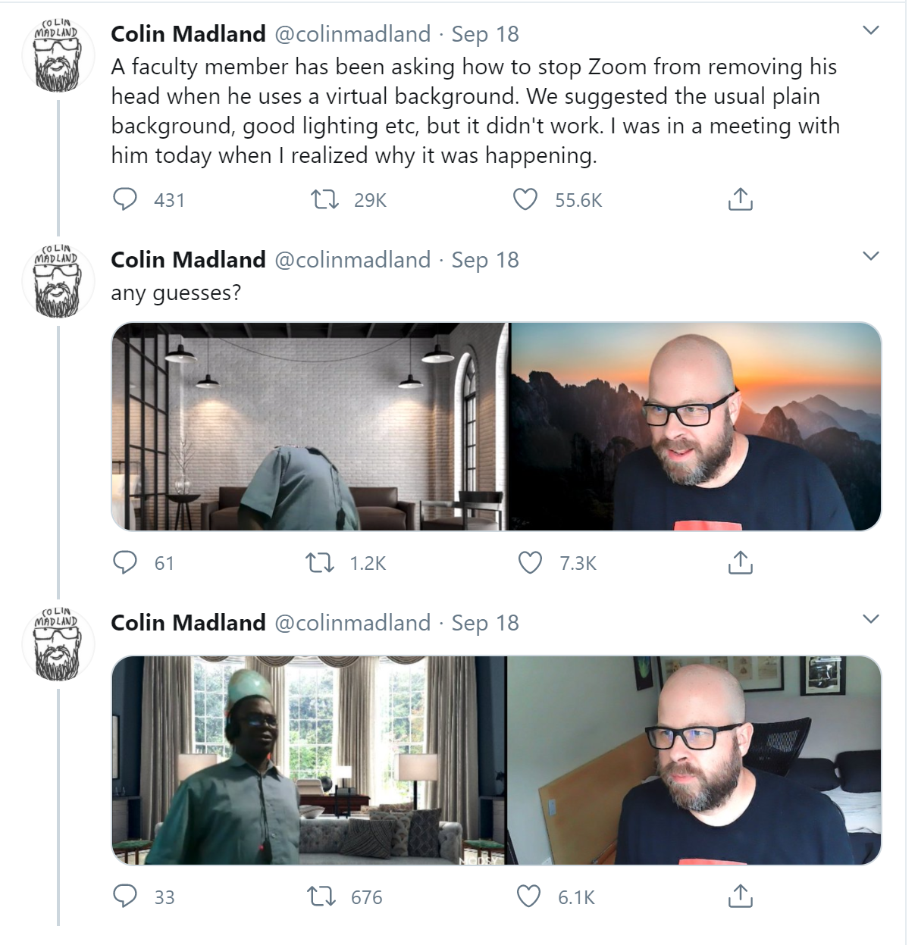
Zoom does not see black people
Notes:
Here’s a fun example: https://techcrunch.com/2020/09/21/twitter-and-zoom-algorithmic-bias-issues/
Actual tweets: https://twitter.com/colinmadland/status/1307111816250748933?lang=en

Slide 11
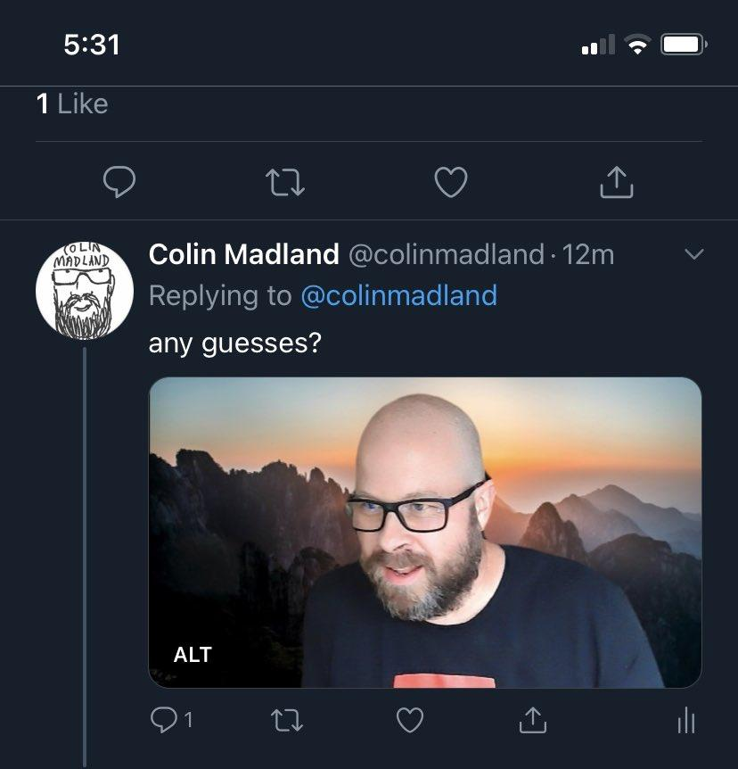
But wait, there’s more!
How did Twitter's algorithm decide to crop the photos?
The same preview is shown no matter what order the original images were set side-by-side.
Notes:
If you look at the image on twitter mobile, it crops out the black professor completely. If you saw this on your phone, you wouldn’t ever see the professor at all, so it’s just apparently a strange reaction photo.

Slide 12
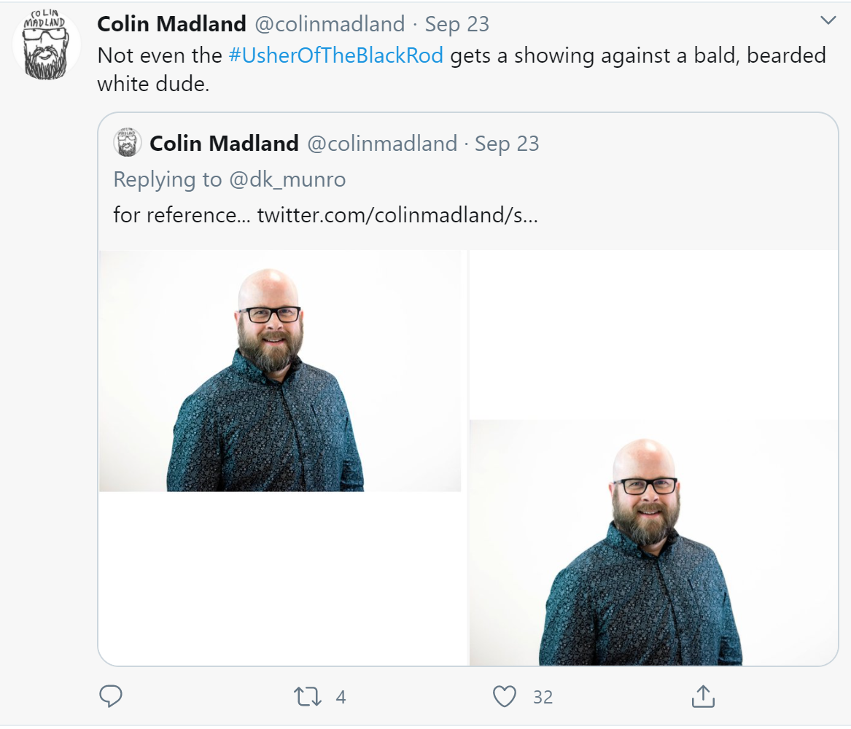
Twitter crops black people out of photos in favor of white people
Notes:
He tried with a few different layouts of images, and the photos were always cropped so that he was visible and the other person wasn’t.
The connection here is that the Twitter engineers probably weren’t testing their cropping algorithms on photos of black people… and you might hypothesize that the reason is because they were mostly white dudes. And they were pulling machine learning data that was mostly of white dudes. If there was a more diverse production team, would someone have been more likely to notice the problem?

Slide 13
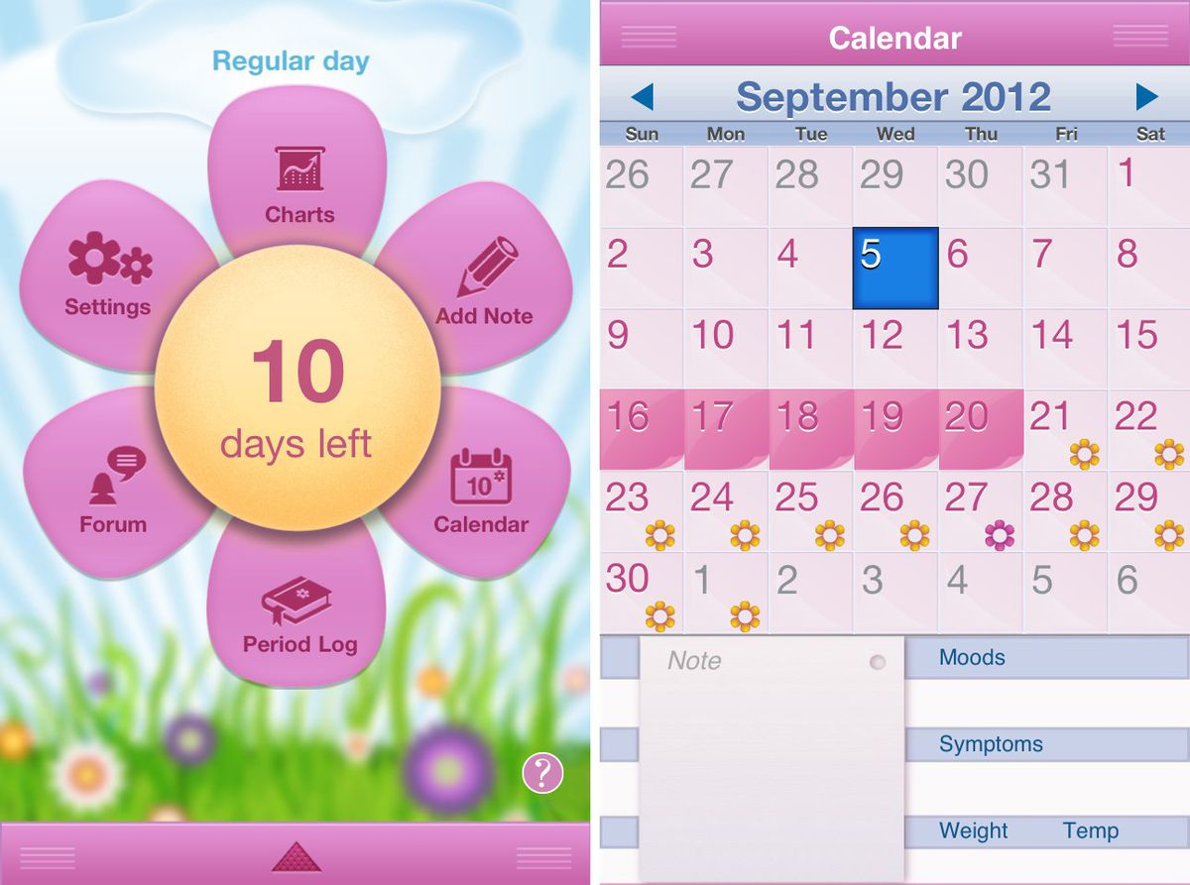
Period Tracking Apps:
by men, for women
There have been free period-tracking apps ever since there have been apps, but they didn’t really boom until the rise of Glow — founded by PayPal’s Max Levchin and four other men — in 2013, which raised $23 million in venture funding in its first year, and made it clear that the menstrual cycle was a big business opportunity.
Glow was even worse. The first onboarding screen asks users to choose their “journey” and provides three choices: avoiding pregnancy, trying to conceive, and fertility treatments. “Five seconds in, I’m already trying to ignore the app’s assumptions that pregnancy is why I want to track my period,” Delano wrote.
By 2016, there were so many choices, surrounded by so little coherent information and virtually zero regulation, that researchers at Columbia University Medical Center buckled down to investigate the entire field. Looking at 108 free apps, they concluded, “Most free smartphone menstrual cycle tracking apps for patient use are inaccurate. Few cite medical literature or health professional involvement.” They also clarified that “most” meant 95 percent.
Notes:
This is a bizarre one, that you may or may not be comfortable talking about. But almost all the Period tracking apps are made by white dudes, without input from women or doctors.

Slide 14
CISC108
Have a great day!
Don’t forget:
Register for Midterm 1
Start Project 1
See ya!

